Slide 1
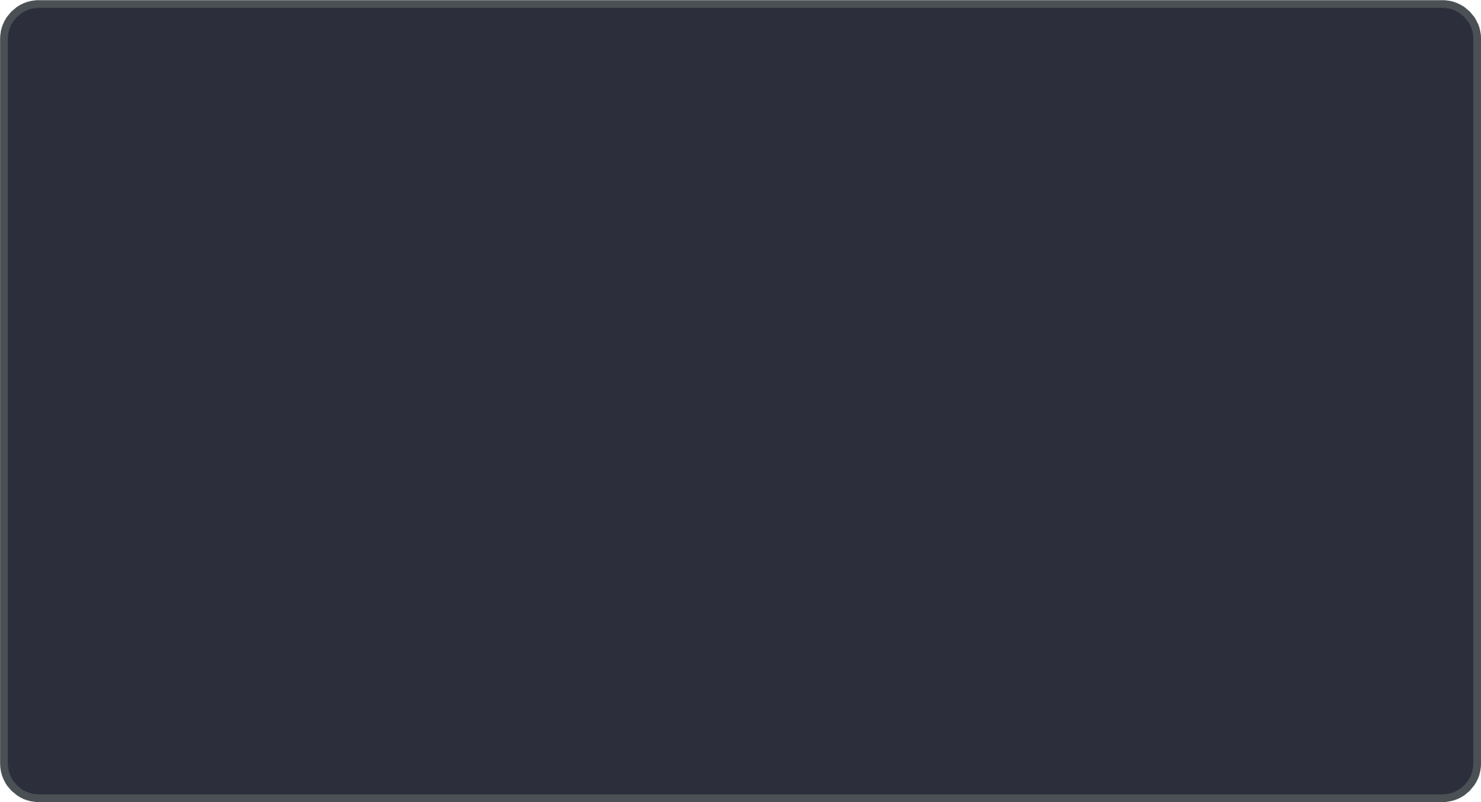

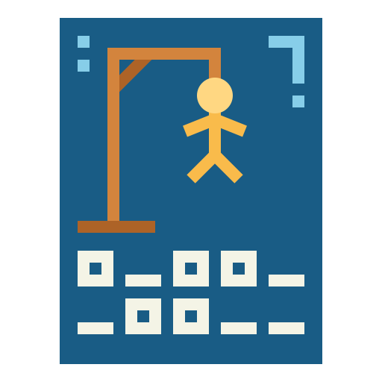
HANGMAN GAME
PROJECT UPDATE
Priyonti Tabassum Haque Dizzya-Al-Fahad
2511777042 2512656642
priyonti.haque.251@northsouth.edu dizzya.fahad.251@northsouth.edu
Sumaiya Yasmin Nairit Avishek Saha
2513948642 2411416624
sumaiya.nairit.251@northsouth.edu avishek.saha.241@northsouth.edu

Slide 2
INTRODUCTION
OBJECTIVES
This project builds a classic Hangman game using the C programming language in a console environment. It serves both as a learning exercise in C programming and as an exploration of basic game logic and user interaction.
KEY FEATURES
Random Word Selection: A word is randomly chosen from a predefined list to ensure variety in each game session.
ASCII Art Visuals: The game displays different stages of a hangman drawing to visually represent wrong guesses.
Interactive Gameplay: The player inputs guesses, and the game dynamically updates the display based on

Slide 3
correct or incorrect guesses.
Win/Loss Conditions: The game ends either when the player correctly guesses the word or reaches the maximum allowed incorrect attempts.
ARCHITECTURE AND CORE COMPONENTS
System Structure:
Input/Output Module: Handles all user interactions, including the welcome message, prompts for input, and displaying game progress.
Game Logic Module: Processes the user's guesses, updates the state (correct and wrong guesses), and determines the win/loss condition.
Display Module: Uses ASCII art to visually represent the hangman’s progression and the current state of the word.

Slide 4
Core Functions:
displayHangman(int attempts): Manages an array of ASCII art strings, each representing a stage of the hangman based on the number of incorrect attempts.
displayWord(const char *word, const int *guessed): Iterates over the word and displays letters that have been correctly guessed, while displaying underscores for the others.
main( ): Orchestrates the game flow, initializes random word selection, manages the game loop, and checks for game termination conditions.
PROGRESS TO DATE
Implemented Features:
User Interface:
Title and welcome messages that introduce the game and explain the rules.
Clear instructions on how to play and the maximum number of incorrect guesses.
Random Word Selection: A mechanism using rand() and srand(time(0)) to randomly choose a word from a list, ensuring each game session is unique.

Slide 5
Game Loop: The loop processes user input, checks each guess against the target word, updates an array tracking guessed letters, and provides feedback on correctness.
Basic ASCII Art: A collection of ASCII art strings is prepared to depict the hangman’s state as the player makes mistakes.
Testing: The game has been tested with multiple inputs, and the logic for handling correct and incorrect guesses is functioning as expected.
CHALLENGES
Input Handling Issues: Handling user input robustly in a console environment can be tricky due to buffering issues and ensuring that extraneous characters are properly managed.
Synchronizing Visual Feedback: Integrating the ASCII art display so that it updates immediately and correctly with each game loop iteration.
Debugging and Testing: Ensuring that the game logic reliably detects win and loss conditions while accounting for edge cases (e.g., repeated guesses).

Slide 6
Randomization Consistency: Making sure that the random word selection provides sufficient variety and that the random seed is set correctly.
FUTURE ENHANCEMENTS
Visual Feedback Enhancements:
Fully integrate the displayHangman() function into the main loop for immediate visual updates
Consider refining the ASCII art to make it more detailed or adding color (using ANSI escape codes) for a better user experience.
Improved Input Validation: Enhance input validation to handle unexpected or invalid inputs (e.g., multiple characters, non-alphabetical characters).
Feature Expansion:
Expand the word list for more diverse gameplay.
Implement a scoring system that rewards fewer mistakes.
Add a replay feature so players can easily start a new game without restarting the program.

